Slide 1
Employee Data Analysis using Excel
STUDENT NAME:
REGISTER NO:
DEPARTMENT:
COLLEGE
S. Priyadharshini.
312206237,asunm295312206237
Commerce
Apollo Arts And Science College

Slide 2
PROJECT TITLE
Employee Performance Analysis using Excel

Slide 3


AGENDA
Problem Statement
Project Overview
End Users
Our Solution and Proposition
Dataset Description
Modelling Approach
Results and Discussion
Conclusion
3/21/2024 Annual Review

Slide 4

PROBLEM STATEMENT
Evaluate individual and team performance, identifying strengths and weaknesses
Inform data- driven decisions on promotion, training, and resources allocation
Improve overall organizational efficiency and productivity.

Slide 5

PROJECT OVERVIEW
.
An employee performance dataset is a collection of data that measures and tracks individual employee performance
Job title and role
Performance ratings (e.g.numerical scores are categories like exceeds expectations “)
Goals and objectives
Salary and bonus information
Promotions and career progression

Slide 6
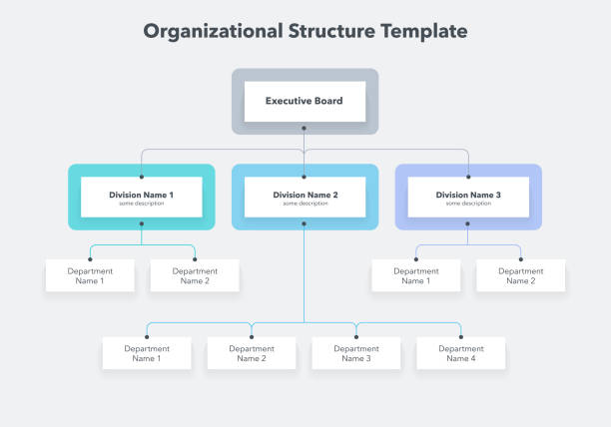

WHO ARE THE END USERS?

Slide 7

OUR SOLUTION AND ITS VALUE PROPOSITION
Conditional formatting - missing errors are identified and highlighted the cells
Filters - removed that blanks value in filter by color
Pivot - summary
Graph - data visualization to easily understand the employee performance dataset.

Slide 8
Dataset Description
Employee = kaggle
26 - features of Employee
Employee ID - In number
Name : First name
Last name
Empty cells : exit cells
Employee performance level - High
Mid
Low
Gender - malevand female
Employee rating- numbers.

Slide 9

THE "WOW" IN OUR SOLUTION
* performance level = IFS ( Z8>=5,”VERY
HIGH”,Z8>=3,”MED”,TRUE,”LOW”)
3/21/2024 Annual Review
9

Slide 10
MODELLING
DATA COLLECTION
•data collection download in kaggle
• For Identifying the Employee performance dataset
•It can help the organization
FEATURES COLLECTION
•Employee ID (unique identitier)
•Name
•Job Title
•Department
•performance rating (e.g.,1-5scale)
•Business units
DATA CLEANING
•Missing value Identifying
•Missing value filter out
PERFORMANCE LEVEL
•In bars to calculate the performance level easily
•high, mid,low value.
10

Slide 11
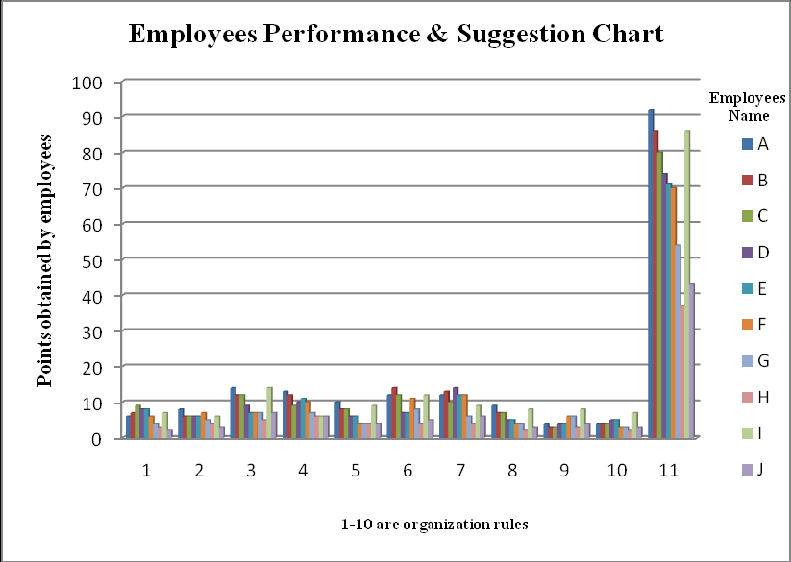
RESULTS
11

Slide 12
conclusion
In conclusion, performance appraisal is an important
Process that provides numerous benefits to both employee amd organizations.it helps employees identifying areas for improvement, set goals, receive feedback, and receive recognition for their achievements.. These insights enable data-driven decisions, targeted and strategic talent management to enhance overall organization performance.

